Slide 1
E-COmmERCE PRODUCT CATALOG
SANTHOSH V 221801047
SUKISH M 221801053
VAISHNAVI S 221801059

Slide 2
INTRODUCTION:
1.Comprehensive Online Shopping Platform : This E-Commerce Management System allows users to browse, select, and purchase products online, offering a convenient alternative to in-store shopping.
2.Enhanced User Experience : Users enjoy features like personalized product recommendations, easy navigation, and secure payment options, making the shopping process seamless and user-friendly.
3.Robust Product and Order Management : Businesses can efficiently manage product listings, inventory, and orders, streamlining sales operations through a centralized interface.
4.Secure Transactions : The system integrates secure payment gateways, safeguarding customer financial information and building trust with buyers.
5.Real-Time Analytics for Merchants : An admin dashboard provides merchants with insights into sales, user behavior, and product performance, empowering data-driven decisions.

Slide 3
Existing system:
The existing e-commerce product management system consists of several key components that streamline operations and enhance customer experience. Product Information Management (PIM) serves as a central repository for all product data, ensuring uniform information across sales channels. The Content Management System (CMS) facilitates the creation of engaging product pages while enhancing navigation and customer engagement. Inventory and Order Management involves monitoring stock levels and predicting future demand based on sales data, helping to maintain optimal inventory. In terms of Pricing and Promotion Management , dynamic pricing adjusts product prices according to market trends, while promotion tools manage discounts and seasonal offers. Analytics and Reporting track key performance indicators (KPIs) and gather insights on customer preferences, informing product strategies. Lastly, Cross-Department Collaboration ensures alignment between marketing efforts and product availability, while providing customer service teams with accurate product information for effective support.

Slide 4
EXISTING SYSTEM – DRAWBACKS:
Complexity of Management : Users may require extensive training, and the abundance of features can overwhelm, resulting in underutilization.
Inventory Challenges : Inaccurate demand forecasting can cause stockouts or overstocking, while rigid systems may struggle to adapt to market changes.
Pricing Management Issues : Manual pricing adjustments can lead to errors, and implementing dynamic pricing can be complicated.
Limited Analytics Capabilities : Data overload can hinder the extraction of actionable insights, and inadequate reporting tools may complicate performance tracking.
Customer Experience Gaps : Inconsistent product presentation and a lack of personalization can negatively impact the shopping experience.
Cost Considerations : High implementation and subscription fees can strain budgets, particularly for smaller businesses.

Slide 5
PROPOSED SYSTEM
The proposed e-commerce product management system aims to enhance efficiency and customer satisfaction by integrating several key features. It includes a unified platform for centralized product information and inventory management, ensuring real-time updates to maintain accurate data. The user-friendly interface features a simplified dashboard and customizable options tailored to different roles. Advanced inventory management utilizes AI-driven predictive analytics for optimal stock levels and automated reordering processes. Dynamic pricing algorithms adjust prices based on market trends, while promotional management tools simplify the creation of discounts and campaigns. Enhanced analytics and reporting offer in-depth insights through comprehensive tools and clear data visualization. The system also focuses on improving customer experience with personalized recommendations and stringent quality control for product information. Finally, flexible pricing models and cloud-based solutions provide cost-effective scalability for businesses of all sizes.

Slide 6
PROPOSED SYSTEM - ADVANTAGES
1. Increased Convenience : Customers can shop from anywhere at any time, improving accessibility and user satisfaction.
2. Streamlined Operations : Automated inventory and order management reduce manual effort, increasing efficiency and minimizing errors.
3. Enhanced Customer Experience : Personalized recommendations make shopping easier and more engaging for users.
4. Secure Transactions : Advanced payment gateways provide high levels of security, protecting user data and building trust.
5. Scalability : The system is built to handle growth, allowing businesses to expand their offerings and user base smoothly.

Slide 7
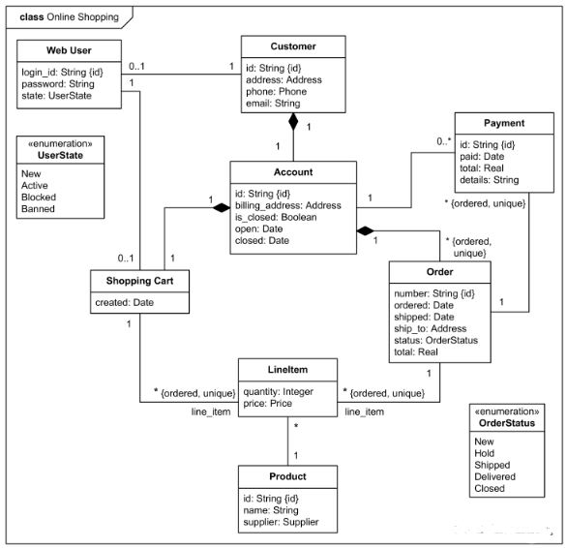
architecture diagram

Slide 8
MODULES
1. User Management Module:
Login/Registration: Handles user authentication, including login, registration, and password recovery.
Profile Management: Allows users to view and update their profile details, such as shipping address and contact information.
Role Management: Differentiates between customer roles and admin roles, managing permissions accordingly.
2.Product Management Module:
Product Catalog: Displays the list of products with details like name, description, price, and availability.
Category Management: Organizes products into categories and subcategories for easier navigation.
Inventory Management: Tracks stock levels and product availability in real time.
Product Search & Filter: Allows users to search for products using various filters such as price range, categories, brands, etc.

Slide 9
3.Order Management Module
Cart Management: Enables users to add, update, or remove products from their cart.
Checkout Process: Guides users through selecting shipping methods, payment options, and reviewing the order before final submission.
Order Processing: Handles order confirmation, payment verification, and dispatching.
Order Tracking: Allows users to track the status of their orders (e.g., pending, shipped, delivered
4. Admin Dashboard Module
Order Management: Admin can view, update, or cancel orders.
Inventory Control: Admin can manage stock levels, add new products, and update product details.
User Management: Admin can manage customers, view customer activity, and handle issues.
Reporting & Analytics: Provides insights into sales, product performance, customer behavior, and other business metrics.

Slide 10
AGILE MODEL
Implementing the Agile software development model for your e-commerce product catalog project would involve dividing the work into small, iterative cycles called sprints. Each sprint delivers a specific part of the system, and the process emphasizes flexibility, ongoing feedback, and continuous improvement.
1. Define Requirements and Initial Backlog
2. Sprint Planning and Task Breakdown
3. Develop and Test in Short Cycles
4. Daily Standups
5. End of Sprint Review and Retrospective

Slide 11
UNIT TESTING
Objective: Test individual functions to ensure they work as expected.
Tools: unit test or pytest in Python.
Examples:
Test create_connection to confirm a database connection is established.
Test create_tables to verify all tables (Users, Products, Orders, OrderDetails, Cart) are created successfully.
Test add_initial_products to ensure that initial products are inserted with correct data.

Slide 12
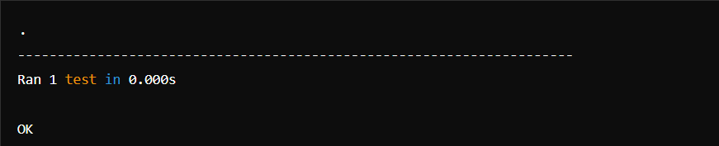
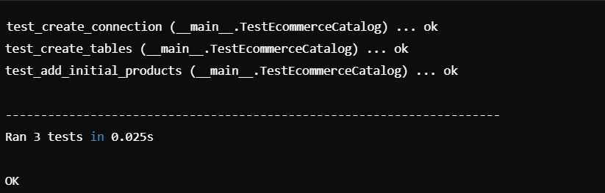
TESTING OUTPUT

Slide 13
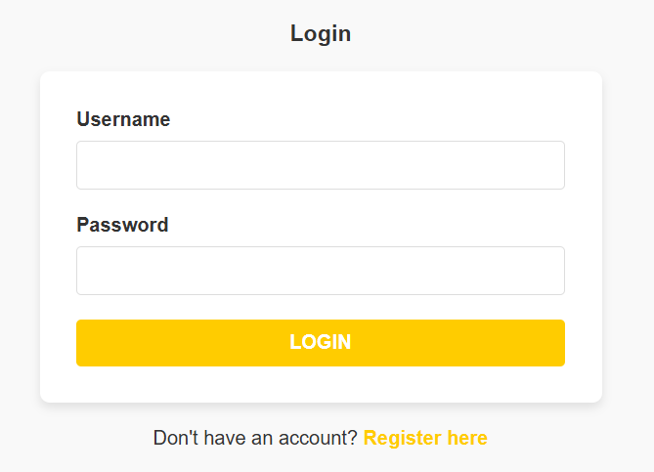
output

Slide 14
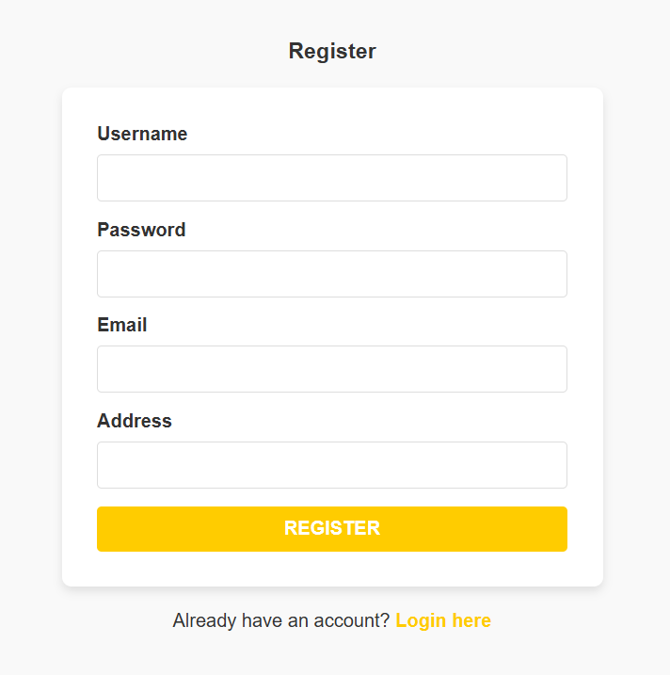

Slide 15
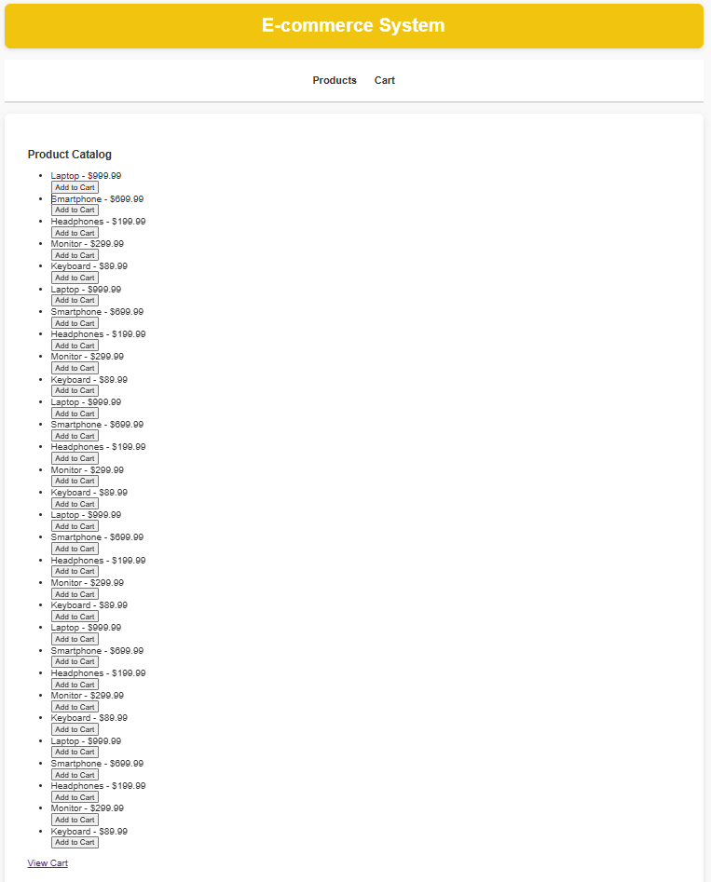

Slide 16
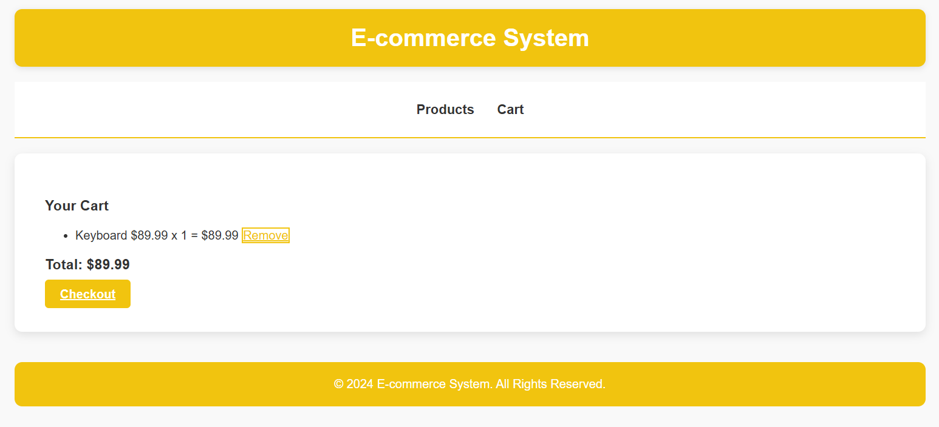

Slide 17
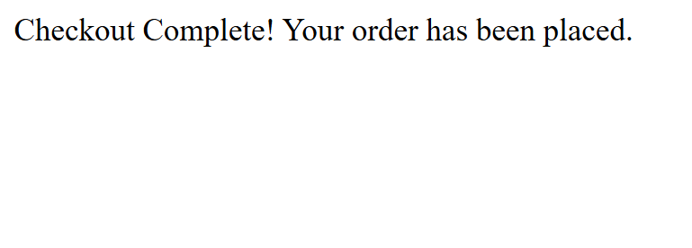

Slide 18
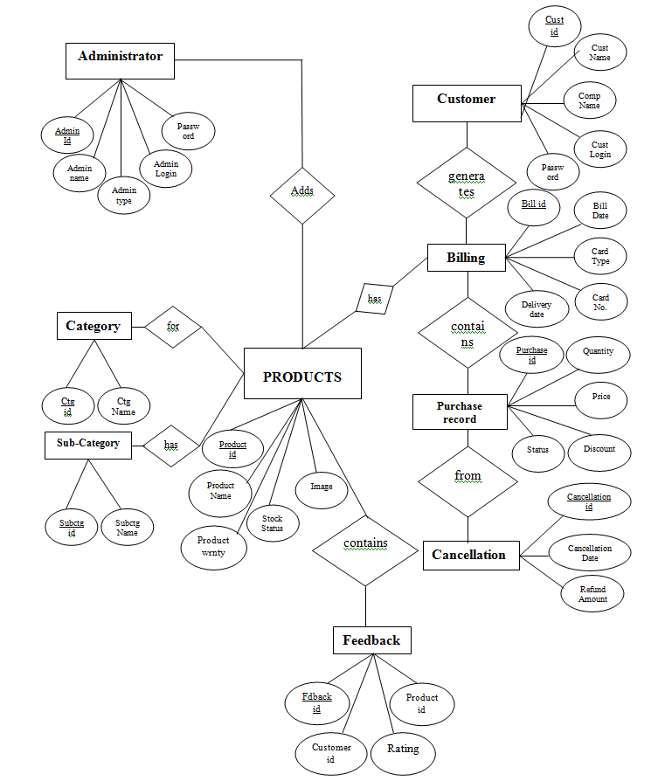
ENTITY RELATIONSHIP DIAGRAM

Slide 19
UML DIAGRAM

Slide 20
CONCLUSION
In conclusion, the E-Commerce Management System project represents a significant milestone in the journey towards creating a more efficient, inclusive, and accessible online marketplace. By leveraging the power of Python, Tkinter, and SQLite, we have developed a versatile and scalable platform that empowers businesses to thrive in the digital age. As we look towards the future, we remain committed to innovation, excellence, and continuous improvement, ensuring that our system remains at the forefront of e-commerce technology for years to come.

Slide 21
REFERENCES
References for Python and Tkinter:
• Python Official Documentation: https://docs.python.org/3/
• Tkinter Official Documentation: https://docs.python.org/3/library/tkinter.html
• "Python GUI Programming with Tkinter" by Alan D. Moore: https://www.amazon.com/Python-GUI-Programming-Tkinter-Moore/dp/1788835883
For SQLite:
• SQLite Documentation: https://www.sqlite.org/docs.html
• "Using SQLite" by Jay A. Kreibich: https://www.amazon.com/Using-SQLite-Jay-A-Kreibich/dp/1449394592
• "SQLite Database Programming for Xamarin: Cross-platform C# Database Development for iOS and Android using SQLite.XM" by Jesse Liberty: https://www.amazon.com/SQLite-Database-Programming-Xamarin-Cross-platform/dp/1484224637

Slide 22
THANK YOU

